Slide 2
Onboarding the IT-Line

Slide 3

Onboarding the IT-Line

Slide 4
Onboarding the IT-Line
BEE / LKQ

Slide 5

“Tell me and I forget, teach me and I may remember,
involve me and I learn.”
Benjamin Franklin

Slide 6



“Tell me and I forget, teach me and I may remember,
involve me and I learn.”
Benjamin Franklin

Slide 7
If we want a student to learn this

Slide 8
If we want a student to learn this
How do we start?

Slide 9
If we want a student to learn this
How do we start?
A
B

Slide 10

If we want a student to learn this
How do we start?
A
B

Slide 11
If we want a student to learn this
How do we start?
A
B

Slide 12
If we want a student to learn this
How do we start?
A
B

Slide 13
If we want a student to learn this
How do we start?
A
B

Slide 14
“The fun part of the job is scripting and we should involve our students in doing that right from the start because when learning is fun it becomes so much easier.”
Anonimous Team Lead

Slide 15
test
“The fun part of the job is scripting and we should involve our students in doing that right from the start because when learning is fun it becomes so much easier.”
Anonimous Team Lead

Slide 16
test
“The fun part of the job is scripting and we should involve our students in doing that right from the start because when learning is fun it becomes so much easier.”
Anonimous Team Lead
cy.get(‘involved’).contains(‘fun’).click()

Slide 17
Key interactions of scripting
Test Script
Browser & DevTools
Programming Tool

Slide 18
test
Key interactions of scripting
Test Script
Browser & DevTools
Programming Tool

Slide 19

Test Script
We focus on these key interactions
Programming Tool
Browser&DevTools

Slide 20
Test Script
We focus on these key interactions
They are fundamental
Programming Tool
Browser&DevTools

Slide 21
Test Script
We focus on these key interactions
They are fundamental
They are fun to learn
Programming Tool
Browser&DevTools

Slide 22

Test Script
We focus on these key interactions
They are fundamental
They are fun to learn
Programming Tool
Browser&DevTools

Slide 23
Test Script
We focus on these key interactions
They are fundamental
They are fun to learn
Programming Tool
Browser&DevTools

Slide 24



we shield our students from information overload
During onboarding
Test Script
Programming Tool
Browser&DevTools

Slide 25


we shield our students from information overload
During onboarding
Scrum
Test Script
Programming Tool
Browser&DevTools

Slide 26

we shield our students from information overload
During onboarding
Scrum
Project Management
Github Gitlab
Test Script
Programming Tool
Browser&DevTools

Slide 27


This scripting oasis lasts for just one month.
Shangri-La
Shangri-La
After that we engage the student in our daily work routines
Test Script
Programming Tool
Browser&DevTools

Slide 28
Shangri-La
What’s in the Onboarding Program?
Shangri-La
Test Script
Programming Tool
Browser&DevTools

Slide 29

Schedule
Week 1
Start learning the tools and the scripting
Week 2
Pick personal testing project and start userscenario based scripting and testing.
Test Script
Week 3
Prepare for the presentation of the project
Week 4
Present the project to the team and impress the audience
Programming Tool
Browser&DevTools

Slide 30
Educational Goals
Testskills
understanding testing and QA
understanding e2e testing
test scripting
Toolskills
utilizing VScode
utilizing Browser & DevTools
utilizing AI (LLM’s)
utilizing Cypress
Test Script
Learning Skills
utilizing AI and Google
planning and managing
Social Skills
working in a team
presenting your work
discussing your work
Programming Tool
Browser&DevTools

Slide 31

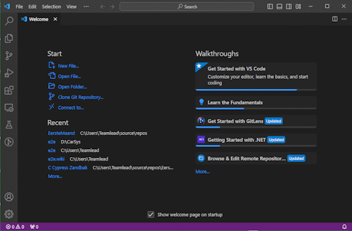
Onboarding materials
Test Script
Programming Tool
Browser&DevTools

Slide 32
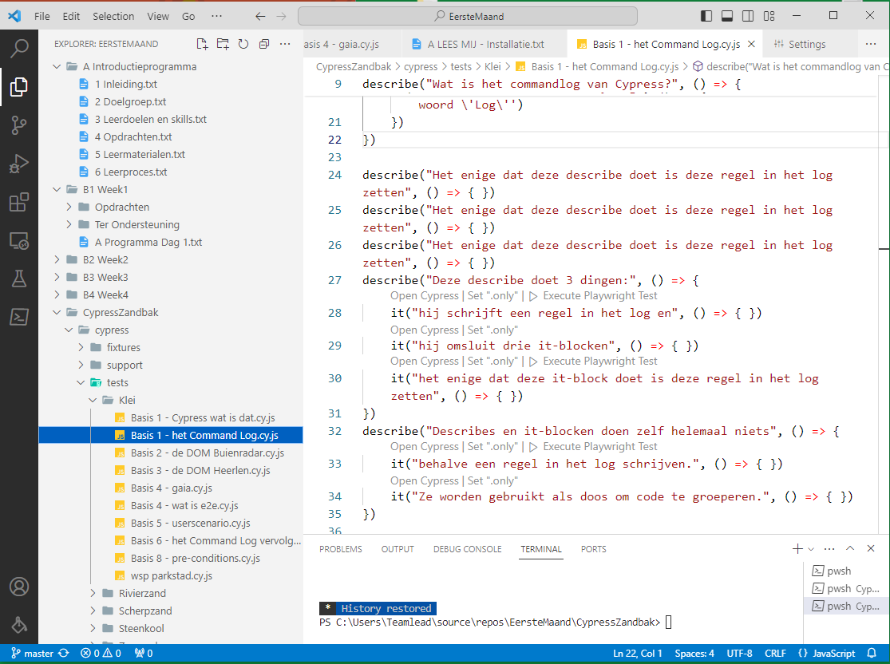
This is a screenshot of the program the student receives. It only exists in VSCode and consists of:
a folder structure with plain text files containing the coursework and resources
a folder containing a Cypress Sandbox with example scripts ready to run.

Slide 33
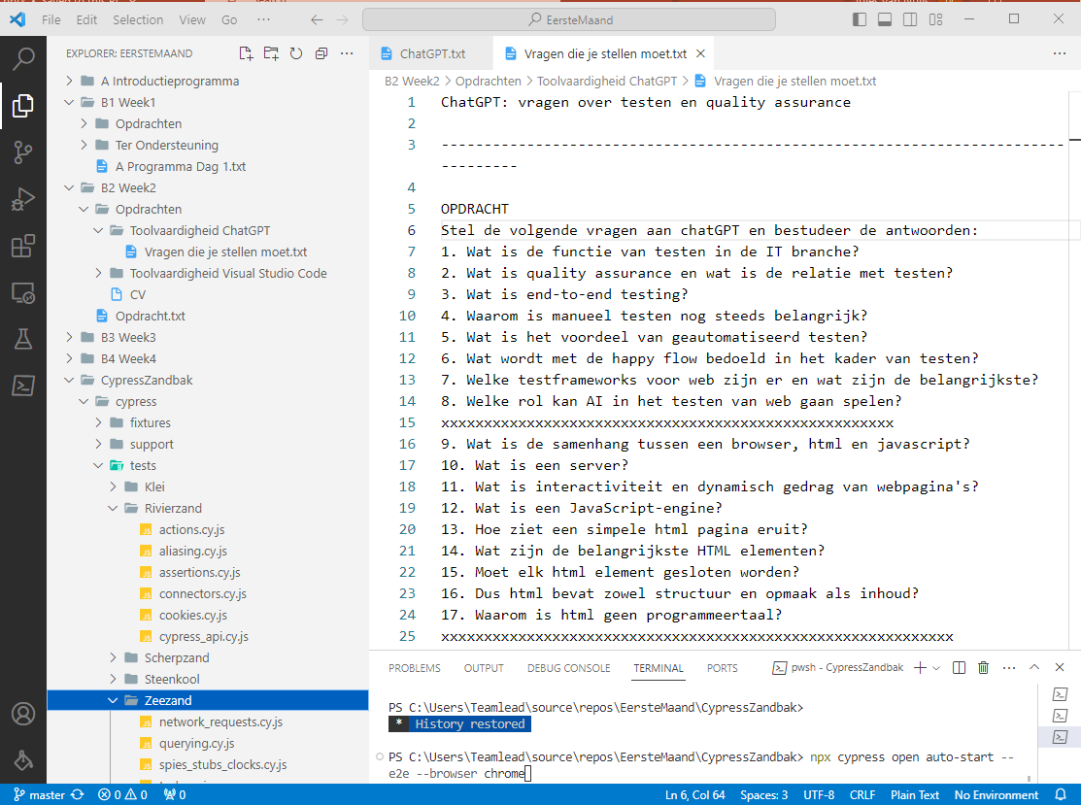
Another screenshot of the program.

Slide 34

Coaching
Daily coaching on location
toolskills
testskills
learning skills
social skills
Test Script
Programming Tool
Browser&DevTools

Slide 35

More…
Our Onboarding Kit will soon be available on Github (including the first test project of a group of 4 new students who absolved the program)
Test Script
Programming Tool
Browser&DevTools

Slide 36
And that is

Slide 37
The End
The End
Test Script
Programming Tool
Browser&DevTools

